Slide 1
Git basics

Slide 2
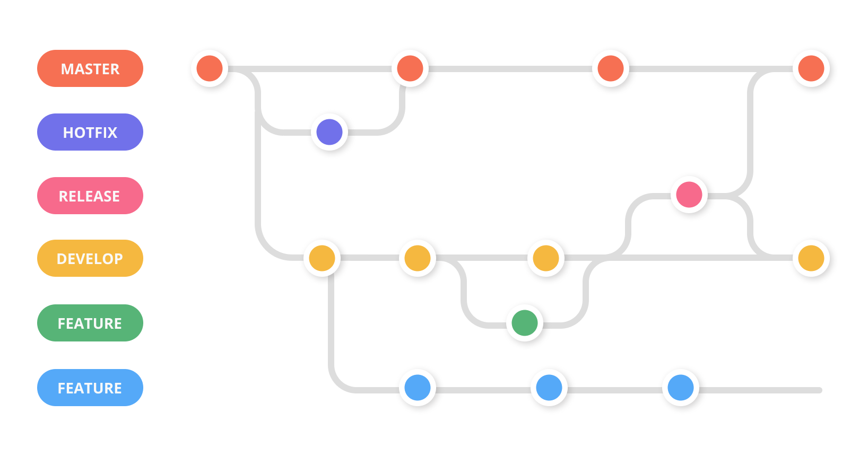
What is GIT
Version management software
Allows multiple people to work on the same project
Aids with keeping track of different versions and merging changes from version A into version B
In depth tutorials:
https://www.coursera.org/learn/introduction-git-github
https://www.udacity.com/course/version-control-with-git--ud123

Slide 3
GIT basics
Command line tool
Keeps track of the complete history of your project
Allows you to jump back and forth within your project’s history
Manages changes
Lots of powerful functions to support this

Slide 4
Most usefull git commands
git clone <https://name-of-the-server>
Clones a repository from the server to your local machine
git branch <branch name>
Creates a new branch
git checkout <branch name>
Switch to a branch
git status
Get the current status of your local repository
git add <file>
Add a file to your local repository so it is now tracked
git commit –m “message”
Commit changes made to your local repository
git push <remote> <branch-name>
Push COMMITED changes in your local repository to a central server
git pull <remote>
Pull updates from the central server to your local repository
git revert <commit>
Revert back to an older commit
git merge <branch>
Merge <branch> into your current branch

Slide 5
Advantages of GIT
Easy management of different versions of your project
Easy management of changes
Easy management of conflicts
Easy to revert changes
Possible to attach extra functionality
Run all unit-tests after a new commit and send an email when they fail
Check linting after a new commit
Enforce reviews

Slide 6
Disadvantages of GIT
Many arcane commands, often with illogical names and extra flags
Only a handful are useful on a day to day basis
Many different ways to achieve the same (e.g. creating a new branch)
It does not support the user beyond the bare minimum:
Lacks dedicated tools for specialized tasks (e.g. resolving merge conflicts)
Does not protect the user from her/him-self
User needs to memorize everything, from commands to branch names

Slide 7




Alternatives to the command line
Many modern IDE’s already have build-in git support
Dedicated GUI’s such as git-tortoise
Dedicated desktop apps from gitlab and github

Slide 8
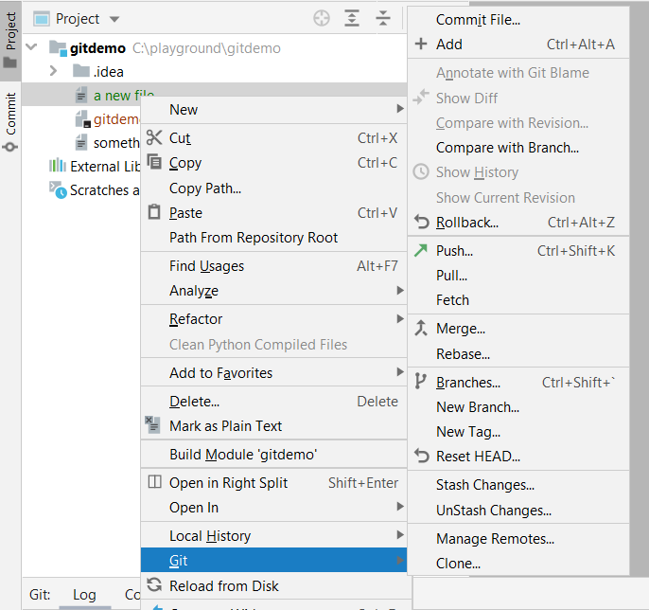
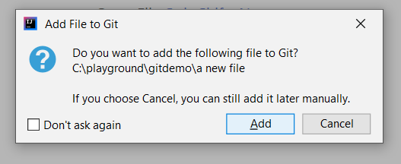
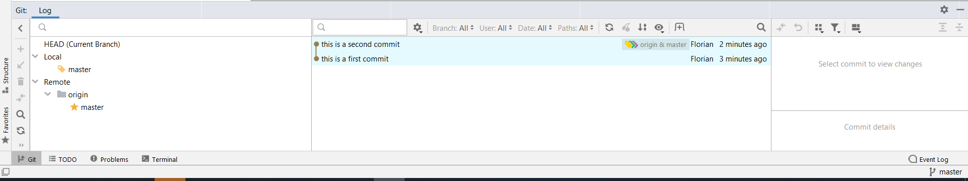
Jetbreans IDE’s (Intellij, pyCharm)

Slide 9
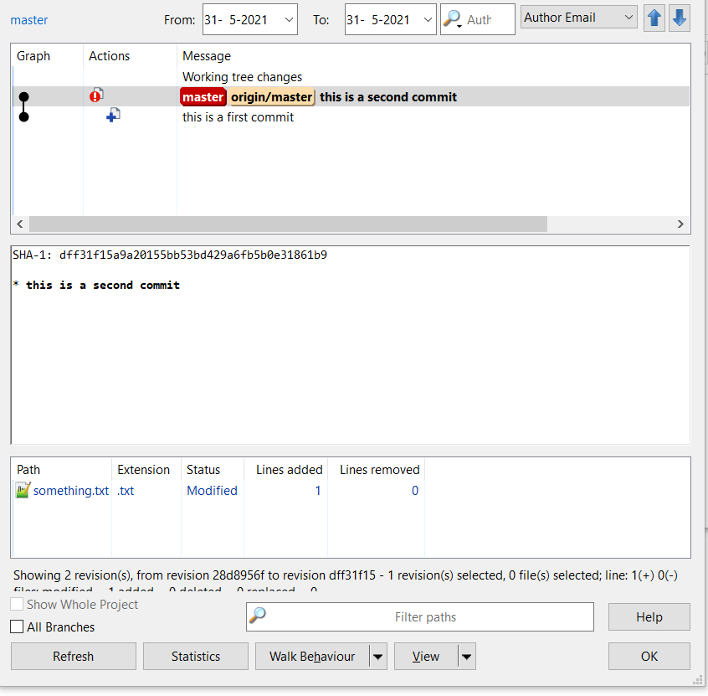
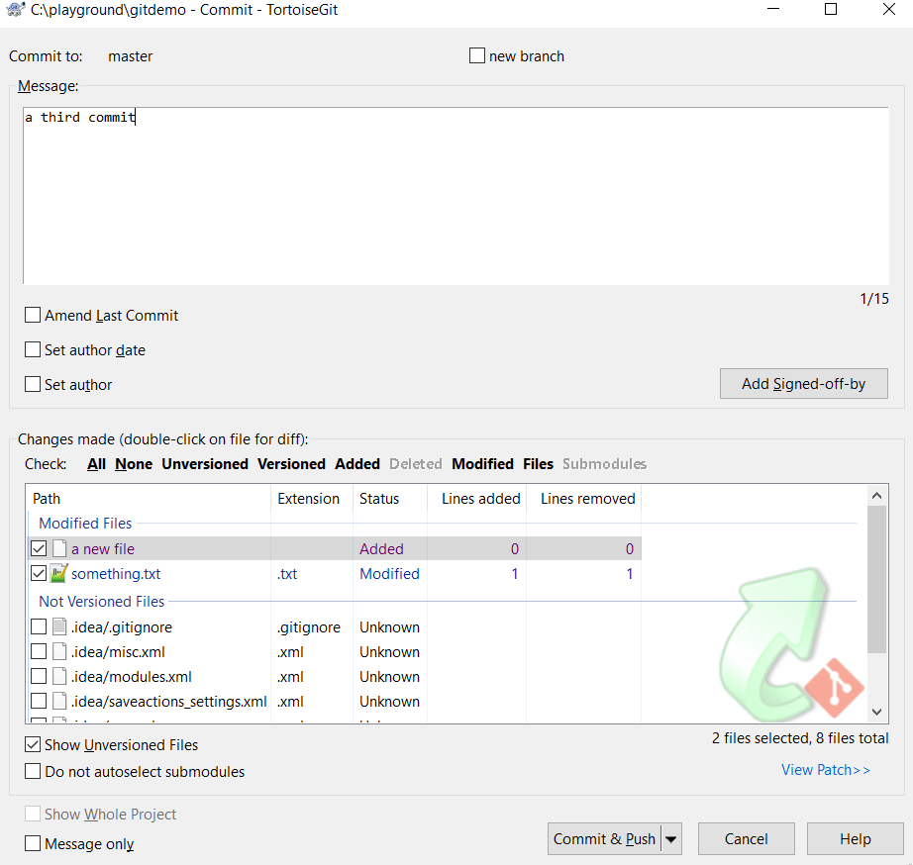
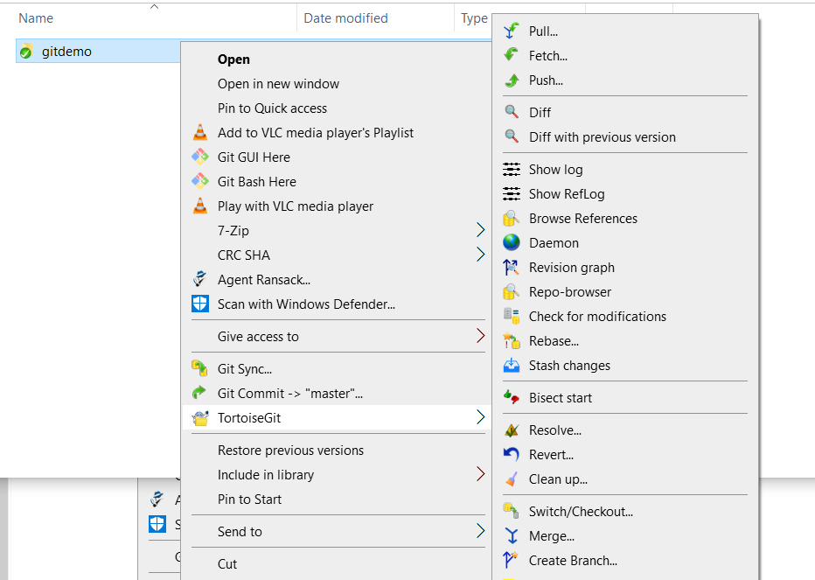
Git tortoise

Slide 10
GUI v.s. CLI
GUI
Advantages:
Supports the user:
Dedicated visual tools for managing history, merge conflicts, branches etc. makes these tasks vastly easier to deal with
Protects the user from himself
Reduces the need for memorization
Simplifies workflow by automating certain tasks
99% of your needs are covered with 4-5 buttons
Disadvantages:
Some exotic commands may not be supported by all GUI’s
CLI
Advantages:
Most powerful version of GIT
You really need to understand what you are doing
Useful for pipeline automation
Disadvantages:
User-support is minimal
Arcane commands
Most commands are not relevant

Slide 11
What tool should I use?
Primarily a case of personal preference
GUI is easier and less frustrating to use because it supports the user more extensively, but some exotic commands may not be available
CLI is more powerful, but the lack of user support makes certain tasks needlessly frustrating

Slide 12
Workflow terminology:
Master/Main: the main version of the repository
Branch: a version of the repository that diverges from the main version. This can be temporary, for example a branch made for the safe implementation of a specific feature, or permanent; for example a release branch.

Slide 13
GIT workflow
Branches are useful for managing project workflow.
If developer #1 working on branch #1 breaks his branch, then developer #2 can still work on his branch.
Especially useful when working on complex, big features, or when implementing features in parallel.
Possible to create stable branches for release versions
Two main strategies: Stable Master & Unstable Master.

Slide 14
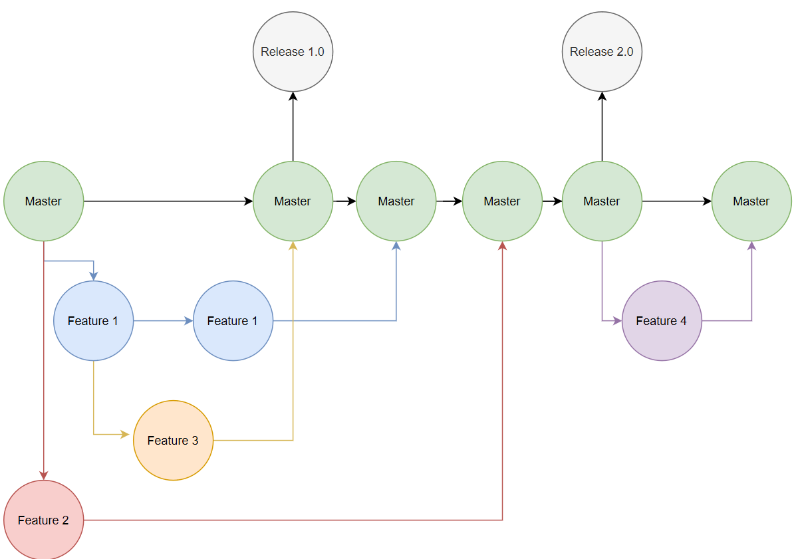
GIT workflow stable master:
No changes are done directly on the master
All work is done in feature branches, these are merged back to the master
Advantages:
Can always fall back on the master when things break
No dependence on other developers or features
Easy to revert to an older version
Disadvantages:
Merging can be complex
Needs coordination between developers; e.g. SCRUM

Slide 15
GIT workflow unstable master:
Changes are done directly on the master
Advantages:
No complex merges
Disadvantages:
Feature 1 can get in the way of feature 2
If one developer breaks the project everyone needs to wait until he/she fixes it
More difficult to go back to older versions when multiple features are being implemented simultaneously

Slide 16
When to use which strategy
Unstable master should only be used for very small changes
Big features should always be implemented in their own branch
Team-members should work on their own features
When creating a release version of your software create a separate release branch
Fixes can be done on this release branch if needed

Slide 17
General Advice
Do’s
Don’t’s
Commit regularly and often, aim for at least once per day
Pull often and regularly if you work in a team
Commit in logical blocks
After finishing a feature
After finishing a unit test
After finishing a method
Commit messages should describe the contents
Wait too long to commit
Make commits too large; don’t combine multiple features
Wait to finish all your work before committing; committing sub-steps is okay, provided they still form a logical block
Make commits too small; don’t commit every time you change a single line of code
Write meaningless commit messages
Let a branch fall too far behind the master
Commit passwords, API keys, or other privacy/security sensitive information; use GitIgnore functionality!

